Slide 1
Lesson 1.1
Getting started with JS fundamentals

Slide 2
Learning Outcomes
Set up your development environment
Refresh your JavaScript skills
Discuss some new JavaScript concepts and tricks
Explain JavaScript programming concepts

Slide 3
Topics
Web application file structure and naming.
Different ways of using JavaScript in your web application.
JavaScript variables, operators, and data types.
Conditional statements.
Loops.

Slide 4
Refresher Activity
Activity 1: Variables
Declare a variable named ‘age’ and assign it a value of 25.
Declare a variable named ‘name’ and assign it a value of "John Doe".
Reassign the value of ‘age’ to 30.
Log both variables to the console.
Activity 2: Operators
Declare two variables, a and b, and assign them values of 5 and 10, respectively.
Use the addition operator to add a and b and store the result in a variable named ‘sum’.
Use the multiplication operator to multiply a and b and store the result in a variable named ‘product’.
Log both ‘sum’ and ‘product’ to the console.
Activity 3: Data Types
Declare a variable named ‘isStudent’ and assign it a boolean value true.
Declare a variable named ‘average’ and assign it a value of 4.5.
Declare a variable named ‘nothing’ and assign it a value of null.
Log the type of each variable to the console.
Activity 4: Conditional Statements
Write a conditional statement to check a variable ‘temperature’.
If ‘temperature’ is greater than 25, log "It's hot outside." to the console.
If ‘temperature’ is between 10 and 25, log "It's nice outside." to the console.
Otherwise, log "It's cold outside.”
Activity 5: Loops
Write a for loop that logs the numbers 1 to 5 to the console.
Write a while loop that logs the numbers 5 to 1 to the console.

Slide 5
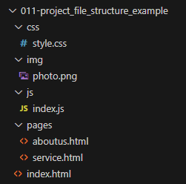
Web application file structure

Slide 6
How to incorporate JavaScript
Three ways to incorporate JavaScript into your web application
Inline Scripting:
Use specific attributes to insert JavaScript code directly onto an HTML element.
Examples: onclick, onkeypress, onmouseover
Internal or Embedded Scripting:
Insert JavaScript code between <script></script> tags located directly in the HTML.
Can be placed in the <head> or <body> tags.
External:
Place JavaScript code in a separate .js file and then link to it in the <head> tag.
Example: <script src=“myScript.js"></script>
Advantages:
Separates design from function.
Makes your code easier to read and maintain.
Cached JavaScript files can speed up page loads.
Notes:
Example: Lesson 1.1 > Inline-Internal-External

Slide 7

Basic Components
Statements (;)
Code blocks { … }
Values: literals and variables
Operators: + - * / =
Expressions: combination of values, variables, and operators which compute to a value.
Keywords: let, var, const, function
Comments: //… or /* … */

Slide 8
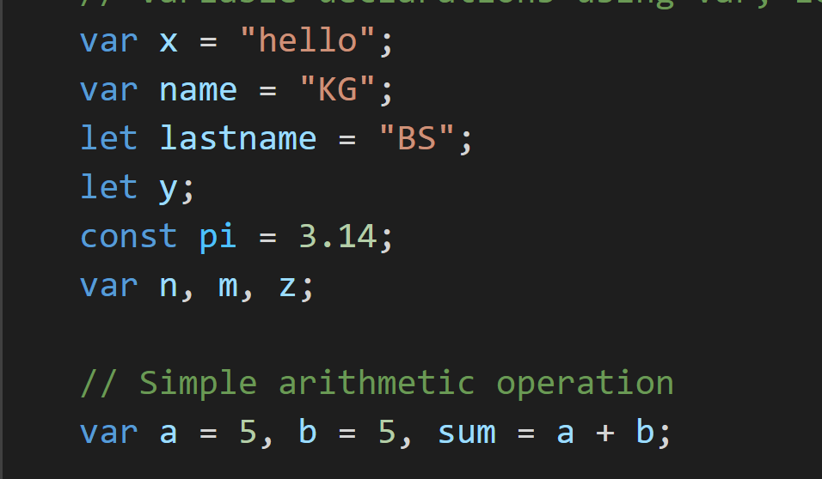
Variables
A variable is a name associated with a piece of data.
Variables allow you to store and manipulate data in your programs.
Use var, let or const to declare variables.
When you declare variable:
Variable name is before the = operator.
Value is after the = operator.
To access each value, you must use the variable name.
Best practices:
Declare all variables at the beginning of a script.
Give variables an initial value. Otherwise, they will be undefined.
Give variables a meaningful name.

Slide 9
Variables
Scope means where a variable is available for use.
var declarations are globally scoped or function/locally scoped.
let is block scoped. A block is a chunk of code bounded by curly brackets { }.
const is also block scoped.
var vs let vs const:
Use const if the value or type should not be changed (const is short for “constant”).
Use let otherwise.
Don’t use var unless you absolutely must support older browsers.
Why? Most programming languages have block scope because it is cleaner and less error-prone. You can declare variables inside blocks (if statements, for loops and so on) without worrying about overwriting some previously declared variable.
https://dev.to/mindninjax/stop-using-var-for-declaring-variables-2p3a

Slide 10
Variables
JavaScript variables are untyped/loosely typed/dynamically typed.
This means that you are not required to correctly predict the kind of data that will be kept in a variable.
Variables do not have explicit data types.
Same variable can have a different data type in a different time and context.
JavaScript variables are case sensitive.
Variables must start with letter.
Variable names cannot contain spaces, punctuation, or start with a digit
Variable names cannot be reserved words.

Slide 11
Data Types
Primitive data types: variables for primitive data types hold the actual value of the data.
Numbers
Strings
Boolean
Null
Variable has been declared and given an empty value.
Null = no value. Null does NOT equal 0 or empty string (“”), because those are values.
Undefined
Variable has been declared, but not assigned a value.
Composite data types: variables for composite data types hold only references to values.
Arrays
Data structure that stores a collection of elements.
Objects
A collection of property/value pairs.

Slide 12
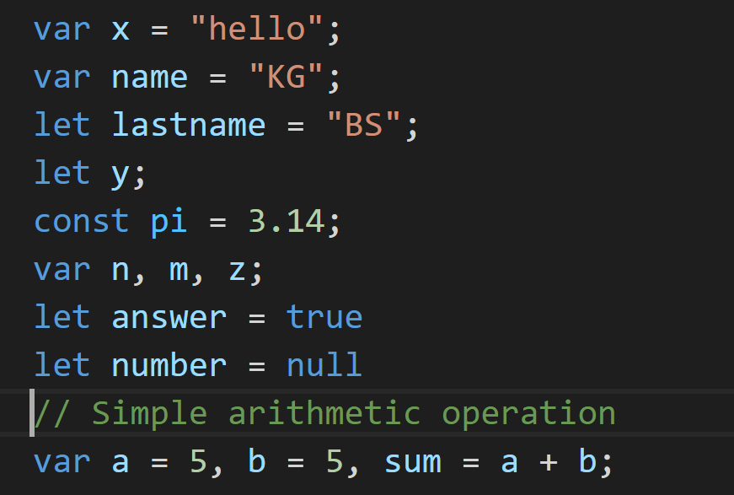
Primitive Data Type Examples

Slide 13
Strings
Can use single quotes (‘ ’) or double quotes (“ ”).
Strings have a “length” property.
let myString = “abc123”;
console.log(myString.length);
JavaScript strings are immutable: all string methods produces a new string without altering the original string.
Commonly used string methods:
charAt, charCodeAt, fromCharCode, indexOf, lastIndexOf, replace, split, substring, toLowerCase, toUpperCase.

Slide 14
Truthy and Falsy
When non-boolean values are used in a boolean context (such as the condition of an ‘if’ statement) they will be coerced into either true or false.
Values that are coerced into true are called truthy.
Values that are coerced into false are called falsy.
The following are falsy values:
false
0 (zero)
‘’ or “” (empty string)
null
undefined
NaN (not a number)
All other values are truthy.

Slide 15
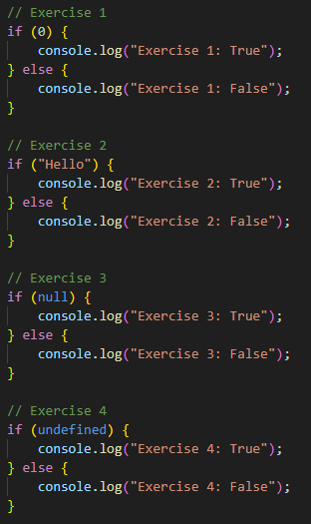
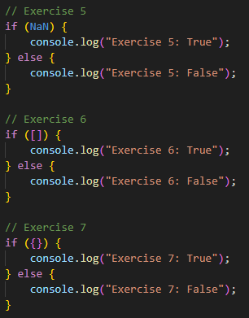
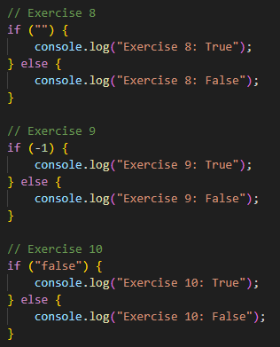
Notes:
What will be the output for each exercise?

Slide 16
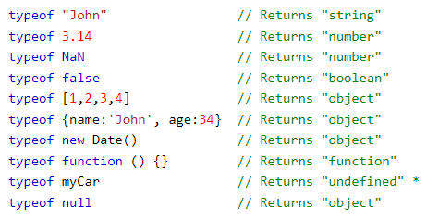
Typeof
Use the typeof operator to find the data type of a JavaScript variable.

Slide 17
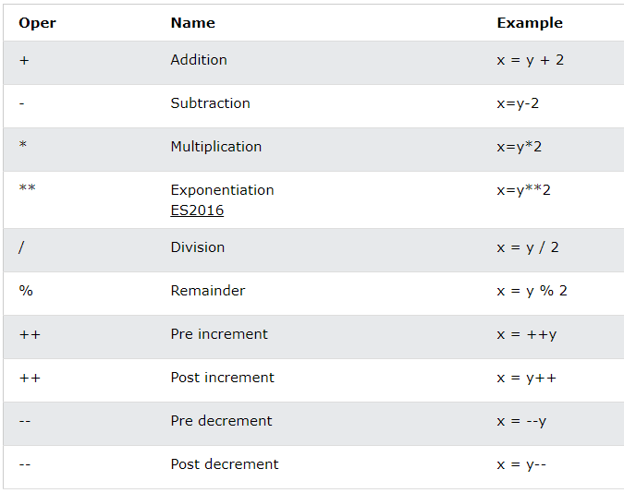
Arithmetic Operators

Slide 18
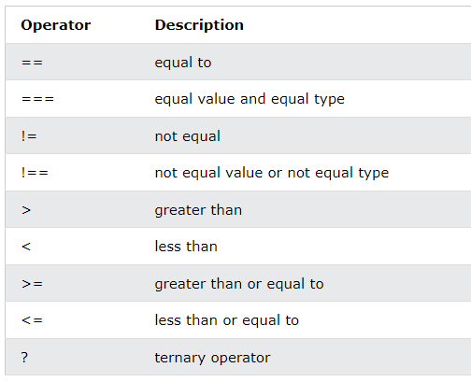
Comparison Operators
Strict equality (===):
Both the value and type of two variables must match for them to be considered equal.
(5 === “5”) returns false
Loose equality (==):
Only the values of two variables are compared. If the types are different then JavaScript forces them to a common type.
(5 == “5”) returns true

Slide 19
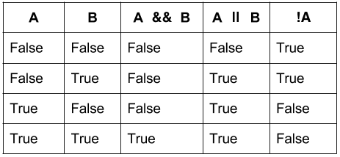
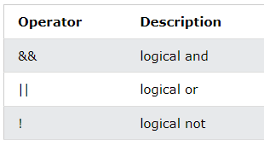
Logical Operators
Example: https://codepen.io/michael-dorsey/pen/MWxJgKr

Slide 20
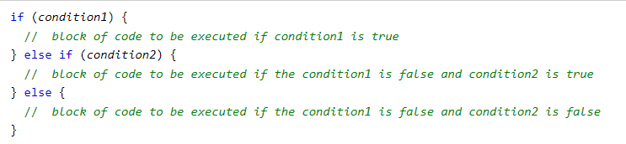
Conditional Statements
Best practices:
Always use { }.
When using else if, always conclude with an else.

Slide 21
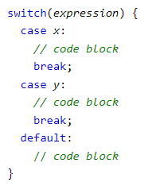
Switch Statements
Use the switch statement to select one of many code blocks to be executed.
When JavaScript reaches a break keyword, it breaks out of the switch block. This will stop the execution inside the switch block.
If you omit the break statement, the next case will be executed even if the evaluation does not match the case.
The default keyword specifies the code to run if there is no case match.
Example: https://codepen.io/michael-dorsey/pen/NWVQYzW

Slide 22
Loops
Useful for executing a block of code any number of times.
Keeps your code DRY (“Don’t Repeat Yourself”)
Saves time and effort in coding by repeating tasks.
Different types of loops:
for
for…in
for…of
while
do…while

Slide 23

For Loop
Expression 1 → executed one time at the start
Useful for initializing a variable used in the loop
Expression 2 → defines the condition to execute the code block
Results in a True or False scenario
If it returns true, the loop will start over again. If it returns false, the loop will end.
If you omit expression 2, you must provide a break inside the loop. Otherwise the loop will never end.
Expression 3 → executed every time at the end of a loop
Useful for incrementing the value of the initial variable
All expressions are optional
Example: https://codepen.io/michael-dorsey/pen/ZEPLzXR

Slide 24

For…In Loop
Loops through the properties of an Object
Each iteration returns a key
The key is used to access the value
Value = Object[key]
Example: https://codepen.io/michael-dorsey/pen/xxBgKXB

Slide 25

For…Of Loop
Loops through the values of an iterable object.
Arrays, strings, maps, etc.
Does not work with objects.
Variable: For every iteration, the value of the next property is assigned to the variable.
Variable can be declared with const, let, or var.
Iterable: An object that has iterable properties.
Example: https://codepen.io/michael-dorsey/pen/RwdKbjW

Slide 26
“Break” and “Continue”
The break statement "jumps out" of a loop.
The continue statement "jumps over" one iteration in the loop.
Breaks one iteration in the loop and continues with the next iteration in the loop.

Slide 27

While Loop
Loops through a block of code while a specified condition is true. The loop is terminated as soon as the condition is false.
First check the condition.
Then execute the block of code.
Caution: If you don’t specify a method for the condition to be FALSE, then the loop will never end (“infinite loop”). This will crash the browser.
Example: https://codepen.io/michael-dorsey/pen/wvOgwPJ

Slide 28
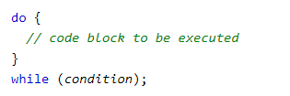
Do…While Loop
Loops through a block of code while a specified condition is true. The loop is terminated as soon as the condition is false.
First execute the block of code once.
Then check the condition.
Then repeat if the condition is true.
Caution: If you don’t specify a method for the condition to be FALSE, then the loop will never end (“infinite loop”). This will crash the browser.
Example: https://codepen.io/michael-dorsey/pen/ZEPLzaj

Slide 29
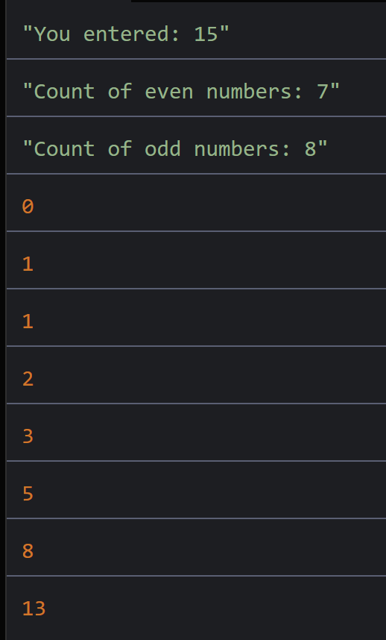
Practice Activity
Starter code: https://codepen.io/michael-dorsey/pen/YzoKNwE
Complete the function countEvenOdd
The input is a number.
Count the number of even numbers in the range of 0 to that number.
Count the number of odd numbers in the range of 0 to that number.
Print the answers to the console.
Complete the function numberSequenceGenerator
The input is a number.
The function prints a sequence of numbers where each number is the sum of the previous two numbers.
The function should continue printing numbers until the next number in the sequence would be greater than the given input.
Use 0 and 1 for the first two numbers of the sequence.

Slide 30
For next class
Read Lesson 1.2 and do Learning Activities 1.2.1, 1.2.2, 1.2.3, 1.2.4.
Read Lesson 1.3 and do Learning Activities 1.3.1, 1.3.2.
Declare any preferences for members of your group project by July 9 (max 3 people in a group).
Assessments Reminder:
All assessment dates have been posted in D2L.
See the “Assignments Policy” for late submission procedures.

Slide 31
References
https://www.w3schools.com/js/js_typeof.asp
https://www.w3schools.com/jsref/jsref_length_array.asp
https://www.w3schools.com/jsref/jsref_operators.asp
https://www.w3schools.com/js/js_switch.asp

